Slide 1


SAP UI5 & FIORI with OData TRAINING using BAS
Anubhav Oberoy
Day – 9

Slide 2

Agenda – Day 9
Working with Aggregation
Models in SAP UI5
Model Basics
Steps to Create a Model
Data Binding Types of Data Binding Syntax
Types of Binding

Slide 3
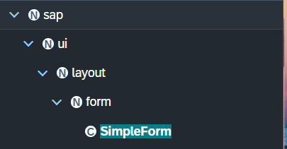
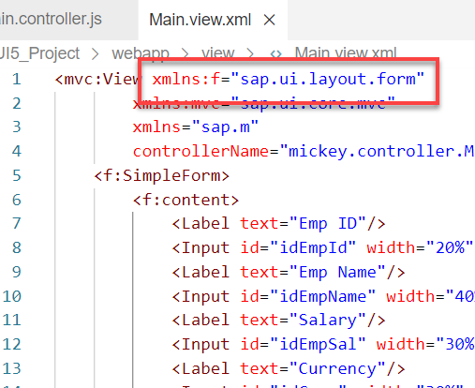
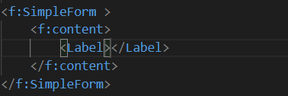
Basics of control hierarchy
To use any control , first we have to include controls’ parent class into the view
For example: To use the SimpleForm we have to include its parent class which is sap.ui.layout.form
The namespace have to given to the parent class
xmlns:f=“sap.ui.layout.form”
When we use the aggregation of any control same namespace will follow by the aggregation as parent.
The control name must start with capital letter and the aggregation name starts with small letter.
We have to check which control will aggregate to the control itself, if the aggregate control is the Control class or element class we can pass any of their child class to the aggregation.
for example:
As the <f:content> extend the element class we can use the <Label> which is also child of element class inside the <f:content>

Slide 4
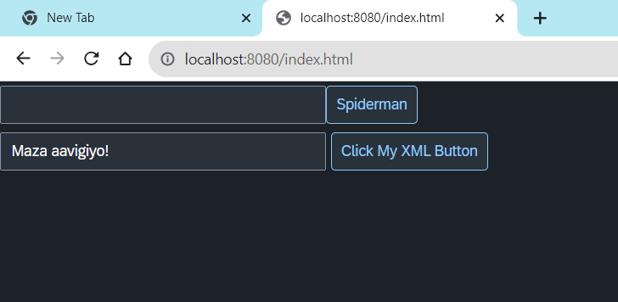
Hands – on: Create First XML View
Now we will create our first XML view.
For that create a new file ‘MyXML.view.xml’ in the view folder of the webapp directory
Then add the View code to this file and save. It will show a button on the screen.
Code Link:-
index.html
MyXML.view.xml
Main.controller.js

Slide 5
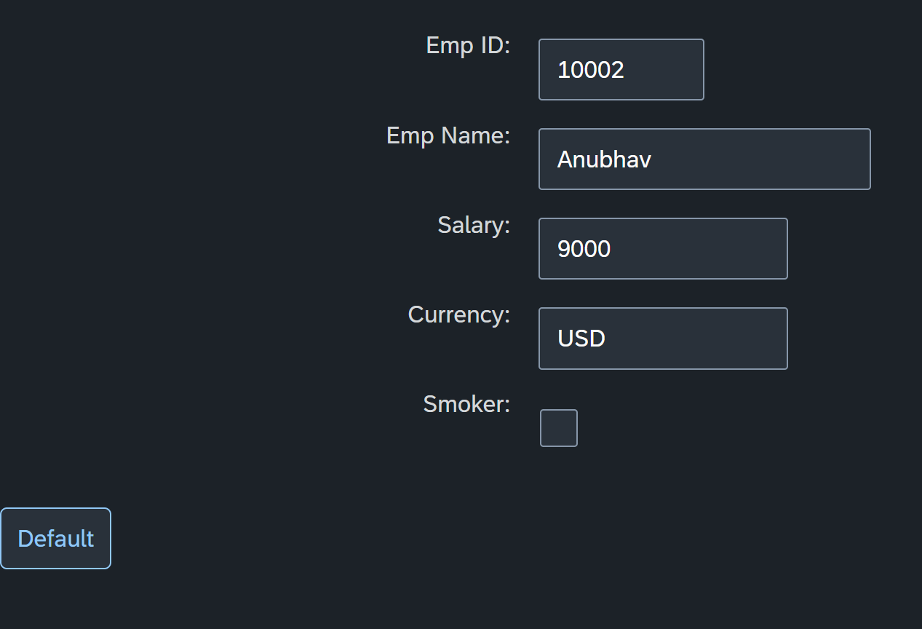
Hands – on: Simple Form Control
Now create a Simple form control in the View.
Along with that we will add a button below the Simple form and on press of that button change the value of one field in the Simple form.
Code Links:-
Main.view.xml
Main.controller.js

Slide 6
Models in SAP UI5
Models are the Object of the data. It contains all the data related to the application .
The various model types supported by SAPUI5 are:
OData model
JSON model
XML model
Resource model
Each model in SAPUI5 is mainly used to bind controls to the data brought in. The JSON model is a client-side model which is recommended for datasets with small amounts of data.
Server Side Model
These three are the Client side model
%
Usage of Models:
100
100
100
95
80
Usage in Percentage
60
40
40
20
Models
OData
JSON
XML
Resource

Slide 7
Model Basics
All the models in SAP UI5 are characterized in two different parts:
Client-Side Model: -
Client Side Model are the models which keeps the data in the browser (client side), when app starts all the data will be loaded in one shot to the browser and kept there.
These models are used when the dataset is small and we want to manipulate data locally.
E.g. why we use internal table? – it’s a temporary store to manipulate the data and once we finalize we push data back.
Server-Side Model: -
Server Side Model are the models which keeps the data in the SAP system(server side), when app starts all the data will be loaded in one demand to the browser in a client side model from, server side model.
These models are used when the dataset is large and we want to fetch and store data back to SAP.
Imagine we have 20trillion records in our sap system, we cant access all data at once in mobile fiori app, so we use server side model to load it chunk by chunk.

Slide 8
Steps to Create a Model
There are 4 Easy Steps to Create a Model:
Step 1: Create a brand-new object of the Model
To Create JSON Model - var oModel = new sap.ui.model.json.JSONModel()
To create XML model – var oModel = new sap.ui.model.xml.XMLModel()
To create Resource model – var oModel = new sap.ui.model.resource.ResourceModel()
To create OData Model – var oModel = new sap.ui.model.odata.v2.ODataModel()
Step 2: Set or Load the data in the Model
oModel.setData({});
oModel.loadData(filePath);
Step 3: Make the model aware to the application/view
sap.ui.getCore().setModel(oModel) -- whole city knows where the gold is
this.getView().setModel(oModel) -- only the single view and its child control knows – only my family
this.getView().byId(“controlId”).setModel(oModel) -- one control have access to data – my dad
Step 4: Data Binding : It is the concept of mapping the Views and Model with which the UI knows where the data is into the model. This is done by calculating the path (address of the data).
Create object of the Model
Set/Load Data in Model
Set Model at View Level

Slide 9
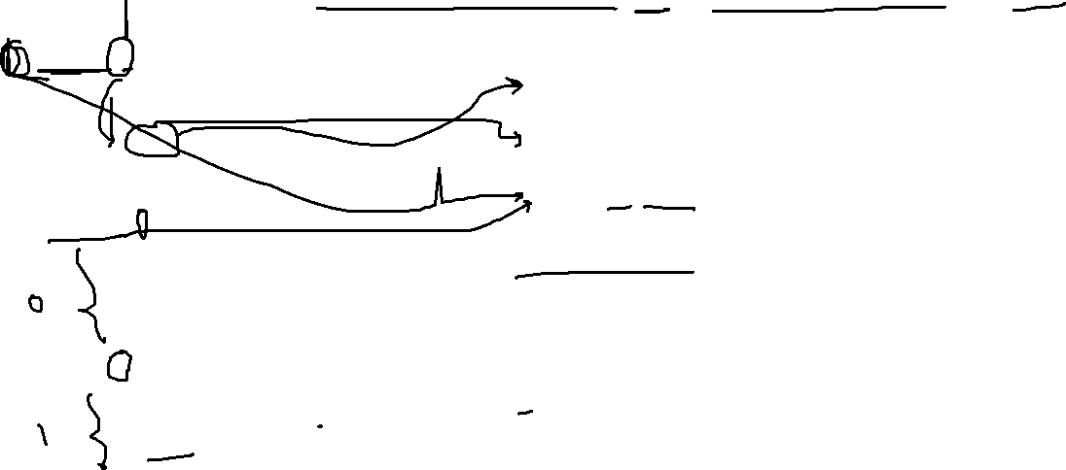
Data Binding
Data binding is the process that establishes a connection between the application UI and business logic.
It is a bridge between a binding target(View) and a binding source(Model).
In the json data we can make address as “Every curly braces is converted to / and every array item is converted to /index”.
{"empStr": {
"empId": 0001,
"empName": "Anubhav",
"salary": 8000,
"currency": "USD"
},
"empTab": [{
"empId": 0009,
"empName": “Ananya",
"salary": 9500,
"currency": "USD“
}, {
"empId": 0010,
"empName": “Shwetha",
"salary": 10000,
"currency": “EUR"
}]}
Q: what is the salary of Anubhav
/empStr/salary
Q. What is the emp name of emp 0001
/empStr/empName
Q. What is the salary of Shwetha
/empTab/1/salary
Q. What is the empId of Ananya
/empTab/0/empId
This is the address of the data
To bind the data with the view we have to give the path of the data , so we have to use the curly braces as :
{/empStr/empName}
This is the path of the data

Slide 10
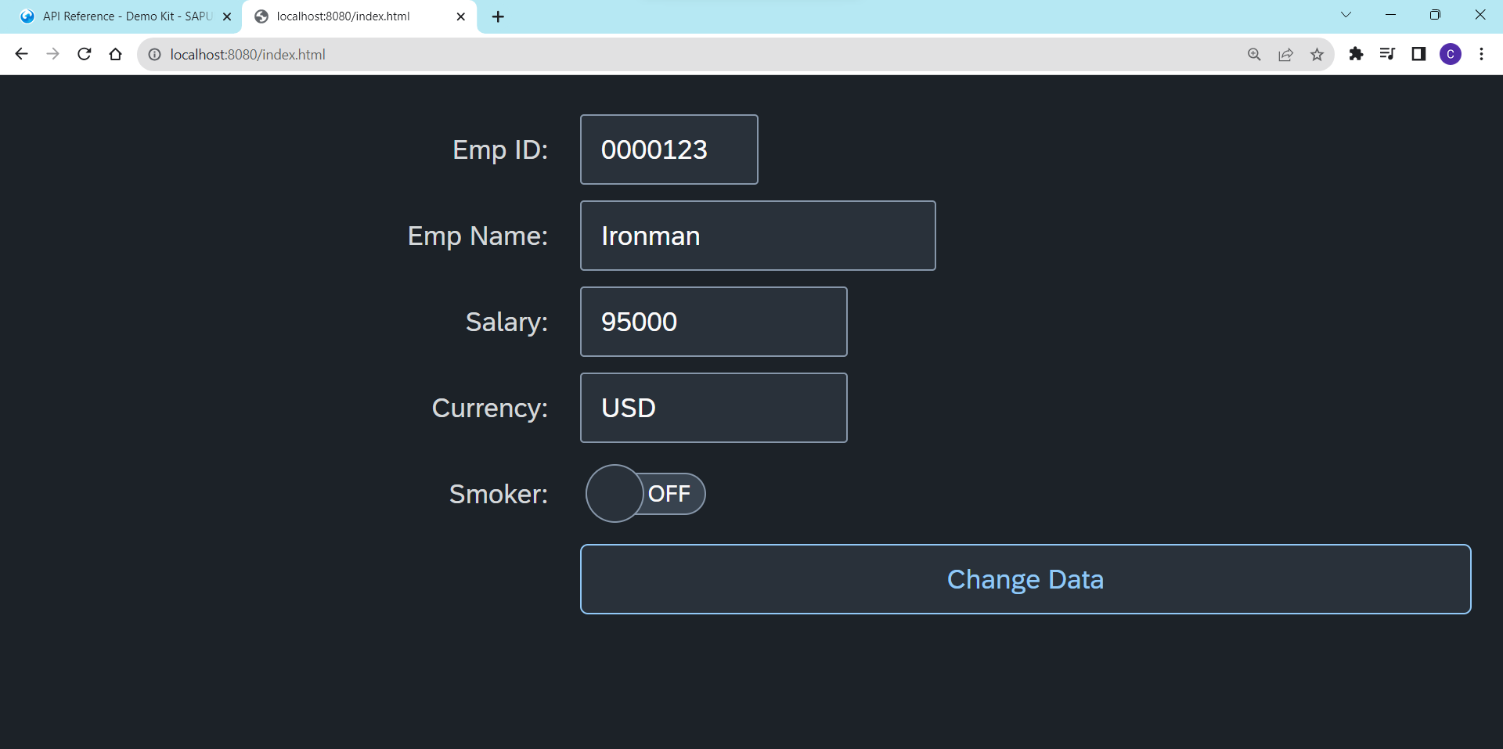
Hands – on: Create our first Model
Create a JSON model by following the steps explained in the previous Slides.
After Creating the Model bind the model to the SimpleForm using different binding Syntaxes.
Code links:-
Main.view.xml
Main.controller.js

Slide 11
Different Methods to Bind Property in View
Binding using the path of the data
{/empStr/empId}
Binding as property specific method:
this.getView().byId(‘controlId’).bindValue(‘/empStr/empSalary’)
Binding as property generic method:
this.getView().byId(‘controlId’).bindProperty(‘value’ , ‘/empStr/empSalary’ )
Binding using the path expression , this is also know as complex binding syntax
{path : ‘/empStr/empId’}
this syntax is helpful when we use formatter .
this syntax will not work by default until we inform it to the SAPUI5, to make this syntax work we have to add a line
code inside the bootstrap code of the application.
data-sap-ui-bindingSyntax= “complex”
Name of the property with which we want to bind

Slide 12
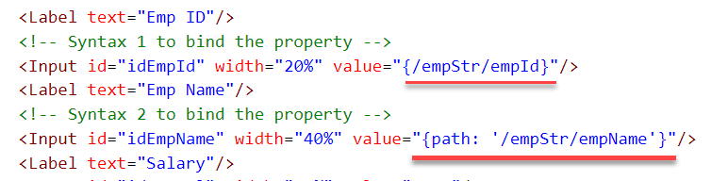
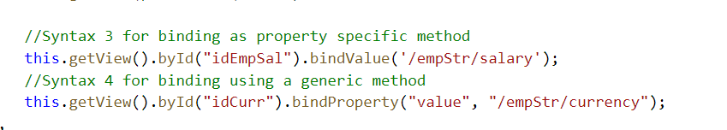
Hands – on: Binding Syntax
Now we will see the different syntax of binding the properties in the View.
Along with that we will see how to align the label and fields in the SimpleForm control.
Code Links:-
MyXML.view.xml
Main.controller.js
Index.html

Slide 13

Types of Binding
SAP UI5 have 4 types of Binding options:
Property Binding
Expression Binding
Aggregation Binding
Element Binding
Property Binding:-
When we bind property of a UI control, to the address/path of the model, this is called property binding. E.g., value property of Input control was connected to /emp/empId
All the four syntaxes we studied in previous slide are the example of property binding.
Ex:-
In XML view:-
<Text text=“{/emp/empId}” ></Text>
In controller: -
this.getView().byId(“controlId”).bindProperty(“text”, ‘/emp/empId’);

Slide 14
var oModel = sap.ui.getCore().getModel();
oModel.setProperty("/empStr", {
Model
<<<Data>>>
UI
<<<Fields>>>

Slide 15
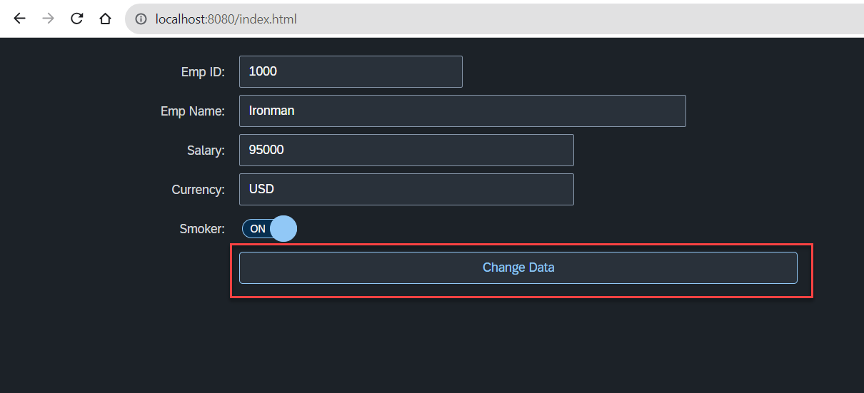
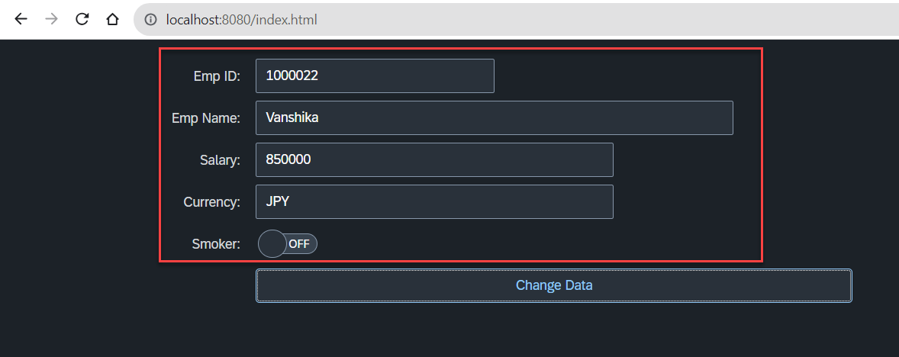
Hands – on: Changing data using Model
Now we will change the form data using the setProperty and getProperty functions.
Initially we used these functions to set the data directly now we will use the Model to change the data.
This process will be done on click of the Change Data button.
Code Links:-
MyXML.view.xml
Main.controller.js

Slide 16

End of Day 9

Slide 17

Questions

Slide 18

Sakshi Gupta

Slide 19


We’re committed to empower you to be
Most Desirable Resource
through powerful training solutions.
We build the workforce of the future.
250+
Corporate Clients
30,000+
Learners Trained
25000+
Learners Placed
FREE WEBINARS
Sign up for free webinars with industry experts every fortnight!
Enroll Now!
Contact us today!
https://anubhavtrainings.com/

Slide 20
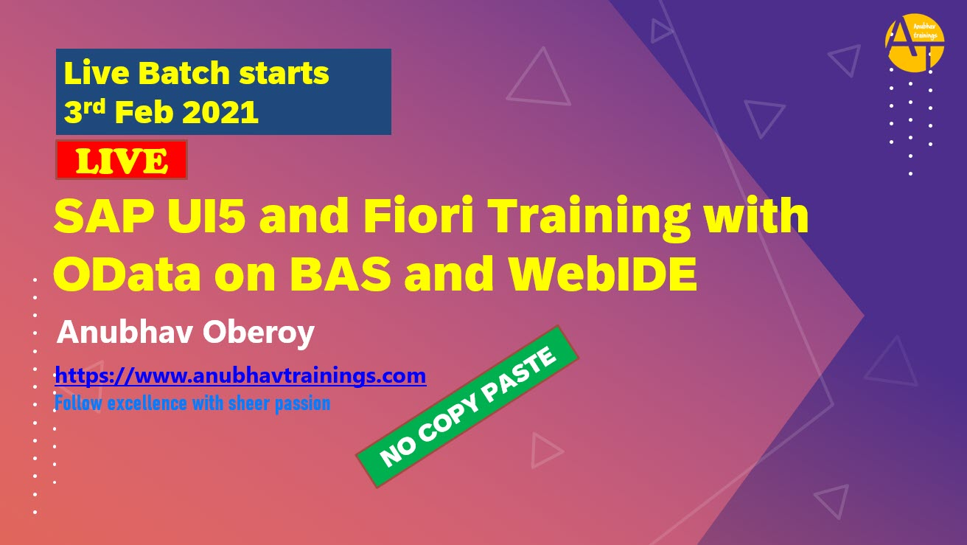


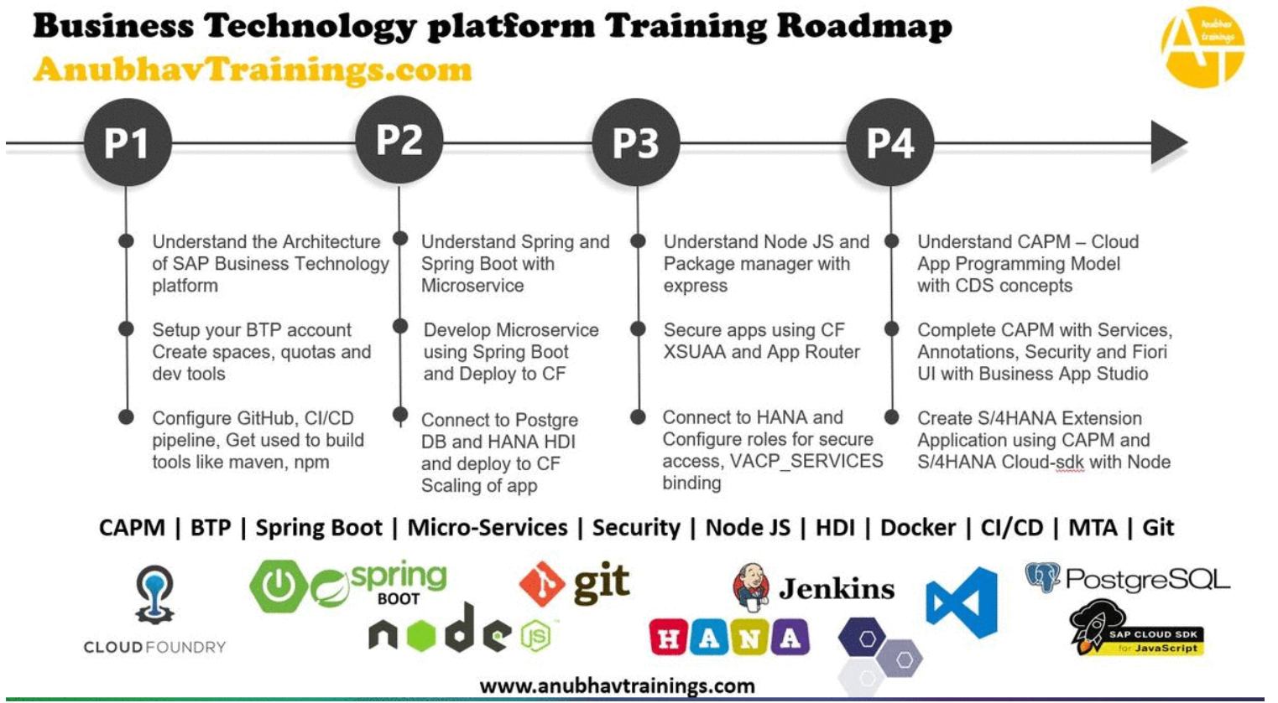
More from AnubhavTrainings.com

Slide 21
Title
Content

